Slide 1

Hotel Reservation Analysis
Sriniha Mourila

Slide 2
Overview
The analysis of the hotel reservation dataset reveals important insights into guest preferences, booking trends, and operational factors that influence the hotel's performance. The dataset comprises various attributes related to hotel reservations, including booking details, guest demographics, stay characteristics, and financial information. This report summarizes key findings from the analysis, highlighting significant patterns and trends.

Slide 3
Key findings
Total Reservations and Popular Choices
Financial Insights
Booking Patterns and Trends
Stay Characteristics
Lead Time
Booking Status

Slide 4
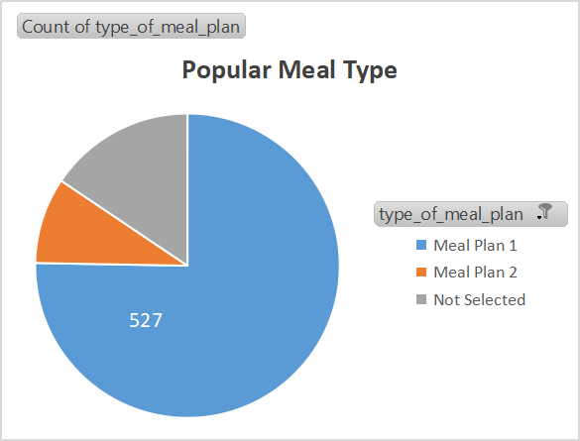
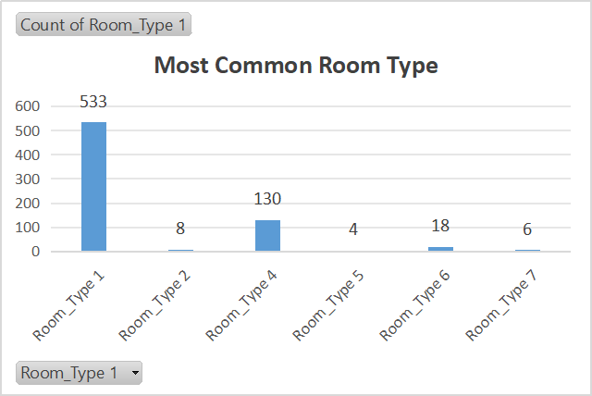
Total reservations and popular choices
Total Reservations: 700
Common Market Segment: Online - 74%

Slide 5




Financial insights
Avg Price for Reservations Involving Children
Popular Room Type and Price with Children
Highest Avg Price by Market Segment
The average price per room for reservations that include children is $144.56.
Room Type 1
$123.12
The Online market segment generates the highest average price per room.

Slide 6
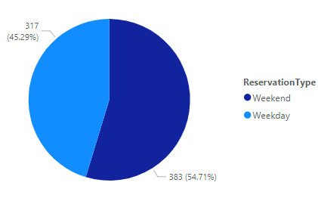
Booking patterns and trends
Reservations by Year
Reservations on Weekends and Weekdays
577
123
2017
2018

Slide 7
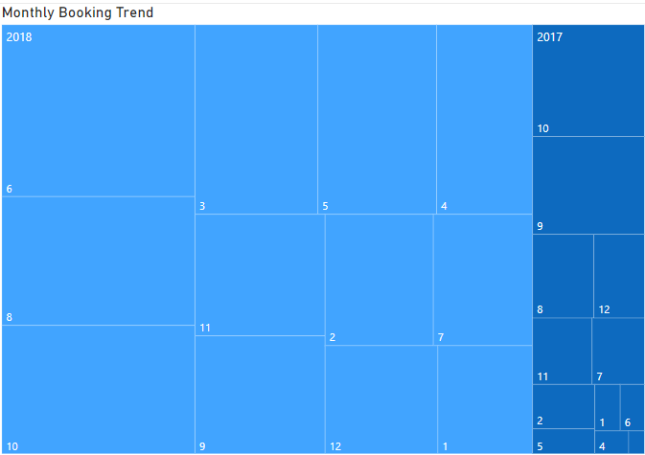
Monthly Booking trends
The peak booking months in 2018 were June (84 reservations), April (67 reservations), and October (63 reservations).
The highest number of reservations in 2017 occurred in October (40 reservations).

Slide 8
Stay characteristics
Average Nights Spent by Room Type
room_type_reserved | Average of no_of_weekend_nights | Average of no_of_week_nights
Room_Type 1 | 0.79 | 2.09
Room_Type 2 | 1.00 | 2.00
Room_Type 4 | 1.09 | 2.71
Room_Type 5 | 0.00 | 2.50
Room_Type 6 | 1.06 | 2.56
Room_Type 7 | 1.00 | 1.67
Room Type 4 is the most popular as the avg. Nights reserved is highest on both weekdays and weekends.

Slide 9




Lead time and booking status
Max and Min Lead Time
Total adults and children across all reservations
Bookings Status
Maximum Lead Time: 443
Minimum Lead Time: 0
Count of Adults: 1316
Count of Children: 69
Non-Cancelled – 493
Cancelled - 207
Confirmed - 0

Slide 10
conclusion
The analysis of the hotel reservation dataset provided valuable insights that can inform strategic decisions for the hotel. Understanding guest preferences, such as the popularity of Meal Plan 1 and Room Type 1, helps in tailoring services and offers.
Identified booking patterns and peak times can assist in resource planning and marketing efforts.
Financial insights, including the average prices associated with different guest demographics and market segments, are crucial for revenue management.

